Slide 1
Notes on software design and C#
By: Matt Boggus
Some material based on Roger Crawfis’ C# slides

Slide 2
Outline
Defining high quality software
C# syntax and examples
Classes and structs
Interfaces
Abstract classes
Class internals
Type conversion
Demo of development environment

Slide 3
Some characteristics of high quality software
Simple
Readable
Maintainable
Reusable
For more specific qualities/principles, read up on SOLID (object-oriented design)

Slide 4
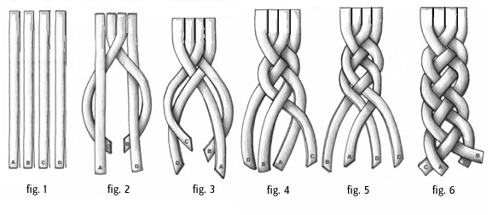
Simple
Composed of a single element; not compound
Complexify: to make complex
Complect: intertwine; interweave; to combine
Related software design principles
SOLID: Singular Responsibility Principle
SOLID: Interface segregation principle
Separation of Concerns
Don’t Repeat Yourself
Image from https://bagntell.files.wordpress.com/2012/02/four_string_braided-strap.jpg

Slide 5
Cohesion
High cohesion
Low cohesion
int Square(int num)
{
return num * num;
}
void DoStuff()
{
BuyTickets();
MakeCoffee();
DriveToMuseum();
CashLotteryTicket();
}

Slide 6
Readable
Function of
Naming conventions
Formatting (white space)
Control flow (problem decomposition)
Reader’s experience with the language
See blockExample classes

Slide 7
Maintainable
Ease of the following tasks:
isolate defects or their cause,
correct defects or their cause,
repair or replace faulty or worn-out components without having to replace still working parts,
prevent unexpected breakdowns,
maximize a product's useful life,
maximize efficiency, reliability, and safety,
meet new requirements,
make future maintenance easier, or
cope with a changed environment.
We’ll come back to this with the Person*.cs examples

Slide 8
Coupling
Loose Coupling
Tight Coupling
IController controller;
controller = new KeyboardController();
controller.Update();
if(myGame.KeyboardCotnroller.
KeyA.isPushed)
{
Jump();
}

Slide 9
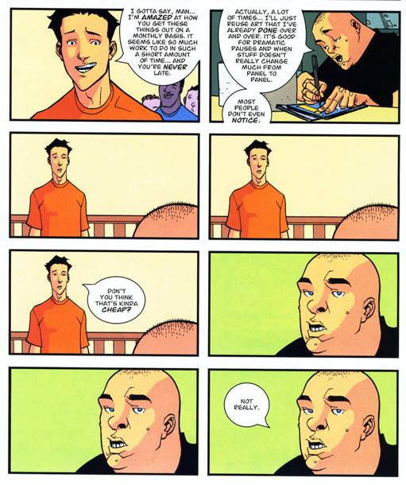
Reusable
Reuse of existing code in other projects
Related software design principle
Composition over inheritance
Identical Panel Gag image from http://tvtropes.org/pmwiki/pmwiki.php/ComicBook/Invincible

Slide 10
Two programming paradigms
Object-oriented Programming
Focus on readability
Objects are an abstraction to be used by client programmers, and should follow a mental model of the actual or imagined object it represents
Objects are “nouns” that have fields “adjectives” and methods “verbs”
More discussion on why OOP is useful here
Entity-Component System
Focus on reusability
Software should be constructed by gluing together prefabricated components like in electrical engineering
Functionality is attached to an object instead of inside its implementation

Slide 11
Why C#?
Fits with
.NET framework
Large library of features and objects; portable and integrates with software written in other languages
Visual Studio
Single point of access for software development, source code control, project management, and code reviews
Additional reasons
Game engines support C# -> XNA, Monogame, Unity
Used in other CSE graphics courses (Game and Animation Techniques; Game Capstone)
More discussion of pros/cons of C# here
More discussion of pros/cons of C# specific to game development here; this subset of comments has some good insights

Slide 12
C# language features
Namespaces
Classes
Fields
Properties
Methods
Events
Structs
Enums
Interfaces (contracts)
Methods
Properties
Events
Control Statements
if, else, while, for, switch, foreach

Slide 13
C# and Java similarities
All classes are objects
Compare System.Object to java.lang.Object
Similar compilation and runtime to Java
Compare Java Virtual Machine to Common Language Runtime
Heap-based allocation
Use “new” keyword to instantiate
Automatic garbage collection

Slide 14
Java to C# resources
Java for C# developers – fairly brief syntax and terminology differences
The C# Programming Language for Java Developers – documentation of language differences organized by programming constructs
Additional Suggestions from StackOverflow

Slide 15
Classes vs. Structs

Slide 16
Classes vs. structs
Both are user-defined types
Both can implement multiple interfaces
Both can contain
Data
Fields, constants, events, arrays
Functions
Methods, properties, indexers, operators, constructors
Type definitions
Classes, structs, enums, interfaces, delegates

Slide 17
Classes vs. structs
Class
Struct
Reference type
Original instance of the object can be modified during execution of method bodies
Value type
A copy of the object is made and operated on inside method bodies
Note: Many types in XNA are defined as structs (ex: Vector2 and Rectangle)
Can pass structs as reference type using ‘ref’ keyword

Slide 18
Class syntax example
public class Car : Vehicle
{
public enum Make { GM, Honda, BMW }
private Make make;
private string vid;
private Point location;
Car(Make make, string vid, Point loc)
{
this.make = make;
this.vid = vid;
this.location = loc;
}
public void Drive()
{ Console.WriteLine(“vroom”); }
}
Car c =
new Car(Car.Make.BMW,
“JF3559QT98”, new Point(3,7));
c.Drive();

Slide 19
Interfaces

Slide 20
Interfaces
An interface defines a contract
An interface is a type
Contain definitions for methods, properties, indexers, and/or events
Any class or struct implementing an interface must support all parts of the contract
Interfaces provide no implementation
When a class or struct implements an interface it must provide the implementations
SOLID: Depend upon abstractions not concretions

Slide 21
Interfaces
Explicit interface
Requires/ensures clauses or pre/post-conditions
Functionality is explicitly defined
Implicit interface
Only method signatures are specified
Ex:
IBird interface defines void Fly()
Duck class implements void Fly { position.y += 5; }
Penguin class implements void Fly { // no-op }

Slide 22
Interfaces example
public interface IDelete {
void Delete();
}
public class TextBox : IDelete {
public void Delete() { ... }
}
public class ImageBox : IDelete {
public void Delete() { ... }
}
TextBox tb = new TextBox();
tb.Delete();
IDelete deletableObj = new ImageBox();
deletableObj.Delete();
deletableObj = new TextBox();
deletableObj.Delete();

Slide 23
Object and interface design
Keep it simple!
The Magical Number Seven, Plus or Minus Two
The average person can hold 7 ± 2 objects in memory at a time
Experts recall more by “chunking” – combining multiple objects into one
Think You're Multitasking? Think Again
The average person is bad at multi-tasking, so focus on what you’re doing if you want it done well
Only provide the minimum amount of functionality required
SOLID: Open to extension, but closed to modification

Slide 24
Abstract Classes

Slide 25
Abstract class
Similar to interfaces
Cannot be instantiated
In some cases, contain no executable code
Can contain method headers/signatures and properties (more on these in a bit), but unlike interfaces they can contain concrete elements like method bodies and fields
Some quirks when working with abstract classes and interfaces
A class that is derived from an abstract class may still implement interfaces
A concrete class may implement an unlimited number of interfaces, but may inherit from only one abstract (or concrete) class

Slide 26
Abstract class example
public abstract class Shape
{
protected int x = 50;
protected int y = 50;
public abstract int Area();
}
public class Square : Shape
{
public int width;
public int height;
public override int Area()
{
return width * height;
}
public void MoveLeft()
{
x--;
}
}
Methods marked as abstract have no bodies and must be overridden
Methods marked as virtual have bodies and may be overridden
See http://msdn.microsoft.com/en-us/library/sf985hc5.aspx for a longer example

Slide 27
Class internals

Slide 28
this
The this keyword is a predefined variable available in non-static function members
Used to access data and function members unambiguously
public class Person
{
private string name;
public Person(string name)
{
this.name = name;
}
public void Introduce(Person p)
{
if (p != this)
Console.WriteLine(“Hi, I’m “ + name);
}
}

Slide 29
base
The base keyword can be used to access class members that are hidden by similarly named members of the current class
public class Shape
{
private int x, y;
public override string ToString()
{
return "x=" + x + ",y=" + y;
}
}
public class Circle : Shape
{
private int r;
public override string ToString()
{
return base.ToString() + ",r=" + r;
}
}

Slide 30
Fields
A field or member variable holds data for a class or struct
Can hold:
A built-in value type
A class instance (a reference)
A struct instance (actual data)
An array of class or struct instances (an array is actually a reference)
An event

Slide 31
Field examples static and instance
public class Variable
{
public static int i = 10;
public int j = 1;
public void test()
{
i=i+10;
j=j+1;
Console.WriteLine(i);
Console.WriteLine(j);
}
}
public class Exercise
{
static void Main()
{
Variable x = new Variable();
x.test();
Variable y = new Variable();
y.test();
Console.ReadKey();
}
}
Output is:
20
2
30
2

Slide 32
Properties
Client side looks like a field
Internally behaves like method calls to get or set the field (i.e. more abstract than a field)
Properties encapsulate a getting and setting a field
Useful for changing the internal type for a field
Useful for adding code or breakpoints when getting/setting a field

Slide 33
Properties – examples
type PropertyName { get; set; }
Examples
int Score { get; set; }
string Name { get; }
double Time { get; private set; }
Code examples
Person*.cs examples [Compare maintainance]
http://www.dotnetperls.com/property

Slide 34
Modifiers
Public
Accessible anywhere
Protected
Accessible within its class and by derived class instances
Private
Accessible only within the body of the class
(Or anywhere if you use reflection)
Internal
Intuitively, accessible only within this program (more specific definition here)
The default, but you should generally pick public or private instead
Static
Belongs to the type
Instance
Belongs to the instance

Slide 35
Access modifier error example
interface GameObject // no access modifier, defaults to internal
{
void Draw();
void Update();
}
public class Monster : GameObject
{
// ... implementations of Draw() and Update() go here ...
}
Cannot have a base class (including interfaces) class less accessible than a concrete class that derives from it

Slide 36
Conversion

Slide 37
Conversion operators
Can also specify user-defined explicit and implicit conversions
public class Note
{
private int value;
// Convert to hertz – no loss of precision
public static implicit operator double(Note x) {
return ...;
}
// Convert to nearest note
public static explicit operator Note(double x) {
return ...;
}
}
Note n = (Note)442.578;
double d = n;

Slide 38
The is Operator
The is operator is used to dynamically test if the run-time type of an object is compatible with a given type
private static void DoSomething(object o)
{
if (o is Car)
((Car)o).Drive();
}

Slide 39
The as Operator
The as operator tries to convert a variable to a specified type; if no such conversion is possible the result is null
More efficient than using is operator
Can test and convert in one operation
private static void DoSomething(object o)
{
Car c = o as Car;
if (c != null) c.Drive();
}

Slide 40
VS 2015 and MonoGame demo

